Slide 1


Challenge #8
Daily CSI
Spot the Differences
Hanging Around
8th Grade Forensic Science
T. Trimpe 2008 http://sciencespot.net/

Slide 2
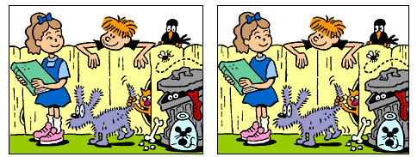
Find the 6 differences between the two pictures.
Source: http://www.slylockfox.com/arcade/6diff/index.html

Slide 3
The answers are …
Answers: Girl’s sock, hole in fence, fly, dress, mouse’s tail, bird’s eye
Source: http://www.slylockfox.com/arcade/6diff/index.html

